Slide 1
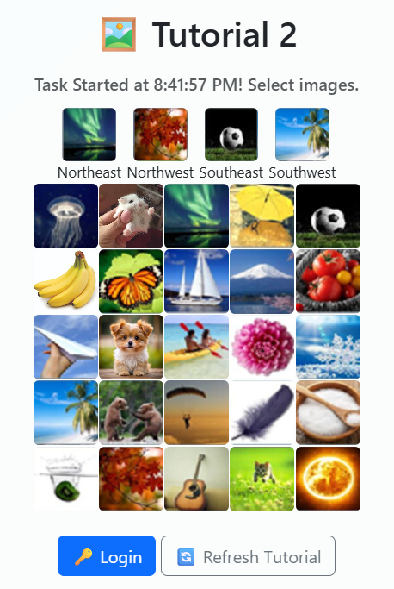


























Registered Password
Registered Direction
You need to use the Registered Password and Registered Direction to find the actual password to login

Slide 2
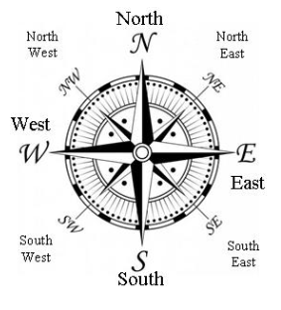
Tutorial 2
We will use :
*PW to represent Actual Password to Click
*RP to represent Registered Password
Tutorial 2 using:
8 Directions Rules – North, South, East, West, Northeast, Northwest, Southeast, Southwest (Tutorial 1 + 4 ordinal direction)
Will have Normal Case
Will have Special Case (when *PW is OUT of the grid)

Slide 3

Tutorial 2: Normal Case Example
*PW
Actual Password to Click
*RP
Registered Password
Northeast
Northwest
Southeast
Southwest
*PW
*PW
*RP
*RP
*RP
*RP
*PW
*PW

Slide 4
Tutorial 2: Special Case 1 Example
*PW
Actual Password to Click
*RP
Registered Password
Northeast
Northwest
Southeast
Southwest
Out of Grid
*RP
*PW
Out of Grid
*PW
*RP
*RP
*RP
Out of Grid
*PW
*PW
Out of Grid

Slide 5
Tutorial 2: Special Case 2 (Corner) Example
*PW
Actual Password to Click
*RP
Registered Password
Northeast
Northwest
Southeast
Southwest
Out of Grid
Out of Grid
*RP
*RP
*PW
*PW
*RP
*PW
*PW
Out of Grid
*RP
Out of Grid

Slide 6
Tutorial 2 – Normal Case Example

Slide 7
Tutorial 2: Registered Password & Registered Direction
Registered Password :
Registered Direction :
Northeast
Northwest
Southeast
Southwest

Slide 8
Tutorial 2: Normal Case
First Image
Northeast
Northwest
Southeast
Southwest
When the Registered Direction is Northeast (up & to right). The Actual Password to Click (*PW) is at Northeast (up & to right) of Registered Password (*RP).
*RP

Slide 9
Tutorial 2: Normal Case
First Image
Northeast
Northwest
Southeast
Southwest
So, the *PW is
*PW
*RP

Slide 10
Tutorial 2: Normal Case
Second Image
Northwest
Northeast
Southeast
Southwest
When the Registered Direction is Northwest(up & to left). The Actual Password to Click (*PW) is at Northwest(up & to left) of Registered Password (*RP).
*RP

Slide 11
Tutorial 2: Normal Case
Second Image
Northwest
Northeast
Southeast
Southwest
So, the *PW is
*PW
*RP

Slide 12
Tutorial 2: Normal Case
Third Image
Southeast
Northeast
Northwest
Southwest
When the Registered Direction is Southeast (bottom & to right). The Actual Password to Click (*PW) is at Southeast (bottom & to right) of Registered Password (*RP).
*RP

Slide 13
Tutorial 2: Normal Case
Third Image
Southeast
Northeast
Northwest
Southwest
So, the *PW is
*RP
*PW

Slide 14
Tutorial 2: Normal Case
Forth Image
Southwest
Northeast
Northwest
Southeast
When the Registered Direction is Southwest (bottom & to left). The Actual Password to Click (*PW) is at Southwest (bottom & to left) of Registered Password (*RP). So, the *PW is
*RP

Slide 15
Tutorial 2: Normal Case
Forth Image
Southwest
Northeast
Northwest
Southeast
So, the *PW is
*RP
*PW

Slide 16
Tutorial 2: Normal Case
Overall
Northeast
Northwest
Southeast
Southwest
Password Need to Click for Successful Login:
*PW1
*PW2
*PW3
*PW4

Slide 17
Out of Grid
Tutorial 2 – Special Case Example
(*PW Out of Grid)
Out of Grid
Out of Grid
Out of Grid

Slide 18
Tutorial 2: Special Case
First Image
Northeast
Northwest
Southeast
Southwest
Out of Grid
*RP
When the Registered Direction is Northeast (up & to right). The Actual Password to Click (*PW) is at Northeast (up & to right) of Registered Password (*RP).

Slide 19
Tutorial 2: Special Case
First Image
Northeast
Northwest
Southeast
Southwest
Out of Grid
*RP
However, the Actual Password to Click (*PW) is Out of the Grid. Therefore, need to wrap to opposite side. So, the *PW is
Wrap to opposite side
*PW

Slide 20
Tutorial 2: Special Case
Second Image
Out of Grid
Northwest
Northeast
Southeast
Southwest
*RP
When the Registered Direction is Northwest (up & to left). The Actual Password to Click (*PW) is at Northwest (up & to left) of Registered Password (*RP).

Slide 21
Tutorial 2: Special Case
Second Image
Out of Grid
Northwest
Northeast
Southeast
Southwest
*RP
However, the Actual Password to Click (*PW) is Out of the Grid. Therefore, need to wrap to opposite side. So, the *PW is
Wrap to opposite side
*PW

Slide 22
Tutorial 2: Special Case
Third Image
Southeast
Northeast
Northwest
Southwest
*RP
When the Registered Direction is Southeast (bottom & to right). The Actual Password to Click (*PW) is at Southeast (bottom & to right) of Registered Password (*RP).
Out of Grid

Slide 23
Tutorial 2: Special Case
Third Image
Southeast
Northeast
Northwest
Southwest
*RP
However, the Actual Password to Click (*PW) is Out of the Grid. Therefore, need to wrap to opposite side. So, the *PW is
Out of Grid
*PW
Wrap to opposite side

Slide 24
Tutorial 2: Special Case
Forth Image
Southwest
Northeast
Northwest
Southeast
When the Registered Direction is Southwest (bottom & to left). The Actual Password to Click (*PW) is at Southwest (bottom & to left) of Registered Password (*RP).
*RP
Out of Grid

Slide 25
Tutorial 2: Special Case
Forth Image
Southwest
Northeast
Northwest
Southeast
*PW
However, the Actual Password to Click (*PW) is Out of the Grid. Therefore, need to wrap to opposite side. So, the *PW is
*RP
Out of Grid
Wrap to opposite side

Slide 26
Tutorial 2: Special Case
Overall
Northeast
Northwest
Southeast
Southwest
*PW4
Password Need to Click for Successful Login:
*PW3
*PW1
*PW2

